Slide 1
BATCH – 91
GREEN TEAM
USER MANAGEMENT SYSTEM
01

Slide 2
TEAM MEMBERS
Deepak Kasumurthy
Puliyanda Nancy
Priyana Poonacha
Rajesh Ravindrareddy
Rishab Bajpai
Riya Tyagi
Rushikesh Bhattad
<number>

Slide 3
ROLES
Deepak Kasumurthy – (FrontEnd tools)
Puliyanda Nancy – (FrontEnd tools)
Priyana Poonacha - (FrontEnd tools)
Rajesh Ravindrareddy – Backend (Java)
Rishab Bajpai – Backend(Java)
Riya Tyagi – (JavaScript and Configuration)
Rushikesh Bhattad – (JavaScript and Configuration)
<number>

Slide 4
CONTENTS
SCOPE AND PURPOSE
TOOLS AND TECHNOLOGIES
WORKFLOW DIAGRAM
SCREENSHOTS
<number>

Slide 5
SCOPE AND PURPOSE
User management is an important part of any web application where manager can create an account and manage the users profile.
User management system provides functionality to manage personal profiles and users. This Procedure does not include physical access to VU computing equipment and IT controlled areas.
We will implement functionality to manage user operations like user registration, user view, user modification login, password reset and edit profile.
<number>

Slide 6
TECHNOLOGIES
MY SQL
JAVA
SPRING FRAMEWORK
MAVEN FRAMEWORK
HTML
CSS
JAVASCRIPT
<number>

Slide 7

TECHNOLOGIES
MY SQL
JAVA
SPRING FRAMEWORK
MAVEN FRAMEWORK
HTML
CSS
JAVASCRIPT
<number>

Slide 8
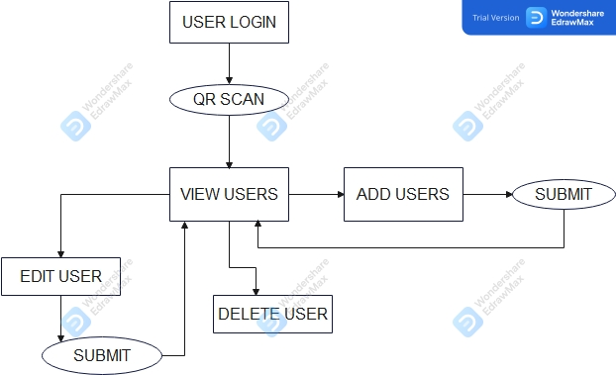
WORKFLOW DIAGRAM
<number>

Slide 9
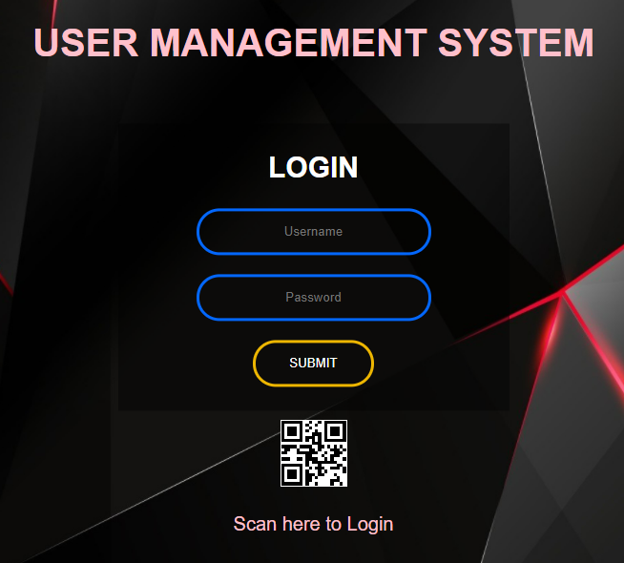
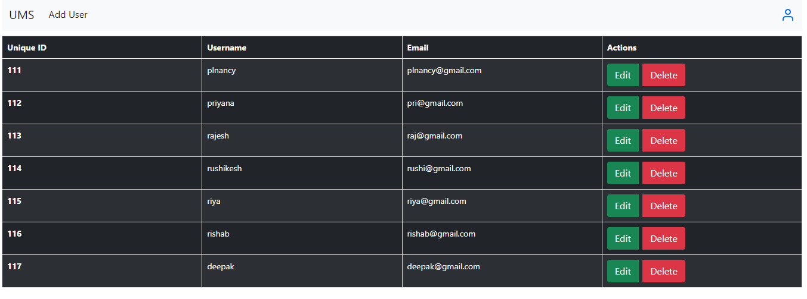
SCREENSHOTS
<number>

Slide 10
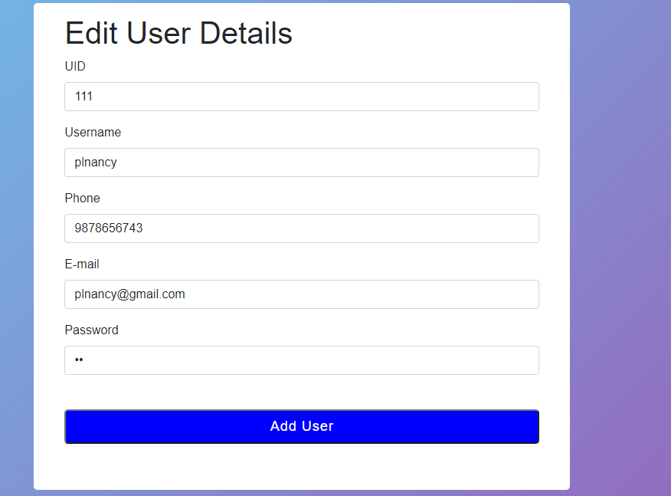
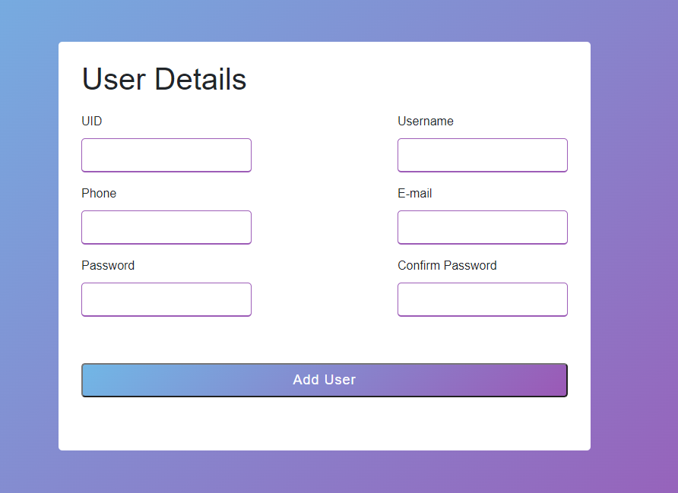
SCREENSHOTS
<number>

Slide 11
Thank you!
<number>

